Slide 1


Lab 05: Construction of Symbol Table
Compiler Construction - Symbol Table Implementation
Submitted By : Maryam Noor(002)

Slide 2
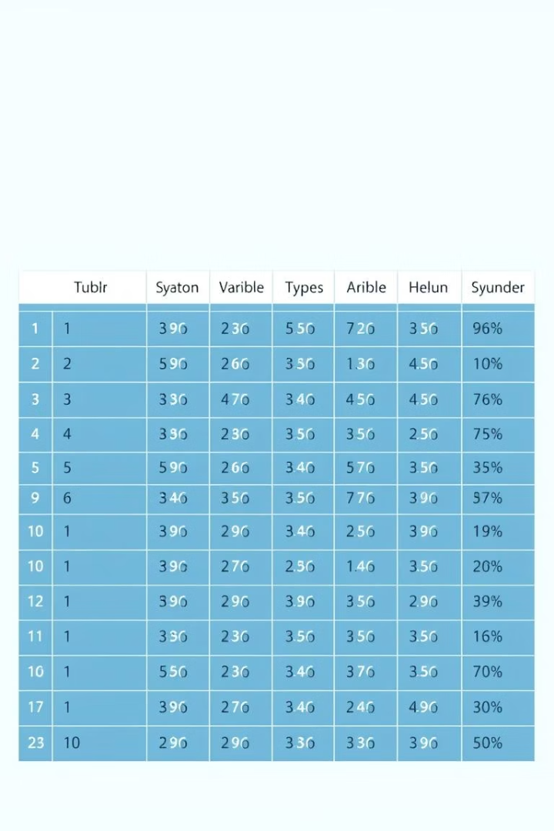


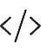
What is a Symbol Table?
Definition
Key Points
A data structure used by compilers to store information about identifiers.
Associates each identifier with its declaration or appearance information.
Implementation
Commonly uses arrays, hash tables, trees, or linear lists.

Slide 3

Symbol Table Data
Core Information
Identifier Name
Data Type (int, float)
Scope (local/global)
Memory Location
Additional Attributes
Line Number
Size
Value
Usage Status

Slide 4





Why Use Symbol Tables?
Identifier Management
Tracks variables, functions, and constants.
Type Checking
Ensures correct variable usage.
Scope Resolution
Handles variable visibility.
Error Detection
Finds undeclared or duplicate entries.

Slide 5
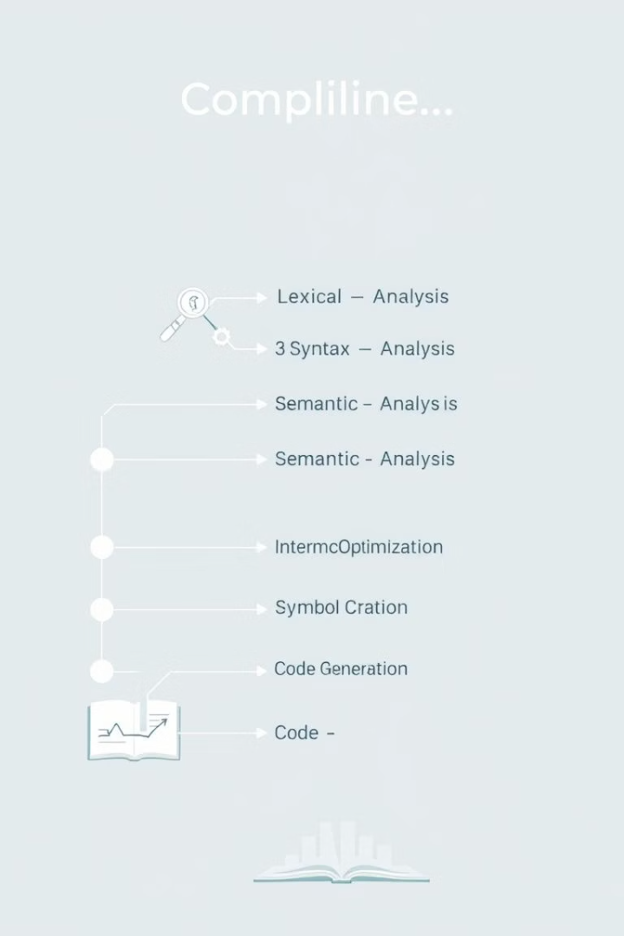
Symbol Table Creation Phases
1
Lexical Analysis
Initial creation, basic identifier recognition.
2
Syntax Analysis
Main construction phase; variables and types identified.
3
Semantic Analysis
Enhanced with scope and type information.

Slide 6
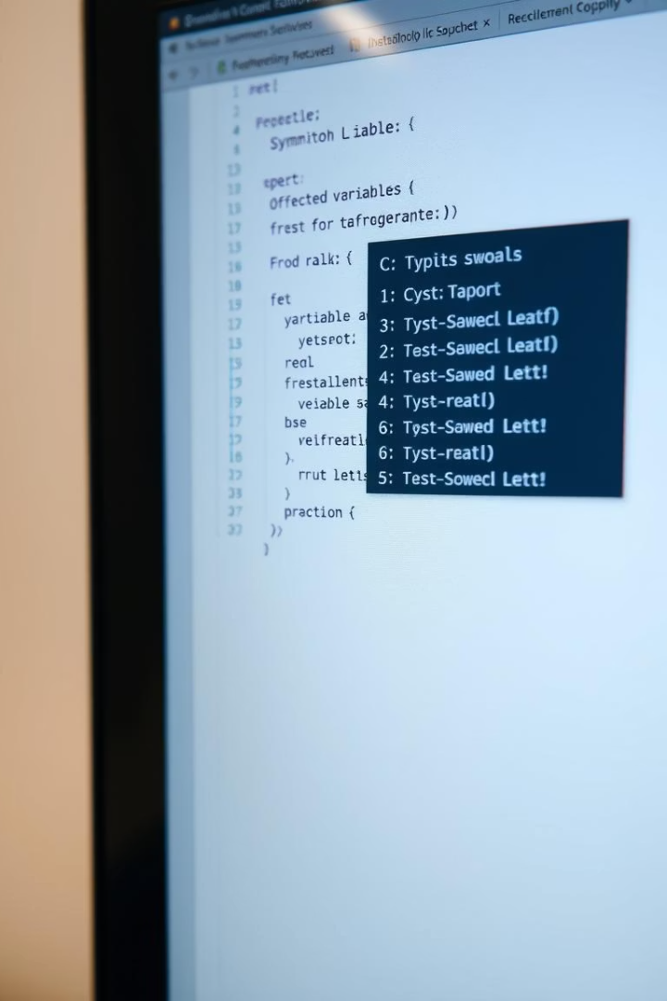
Example: C Code Symbol Table
extern double bar(double x);
double foo(int count) {
double sum = 0.0;
for (int i = 1; i <= count; i++)
sum += bar((double) i);
return sum;
}
Index
Name
Type
Scope
Line
Value
1
bar
function(double→double)
global
1
extern
2
foo
function(int→double)
global
2
defined
3
count
int
local
2
parameter
4
sum
double
local
3
0.0
5
i
int
local
4
1

Slide 7
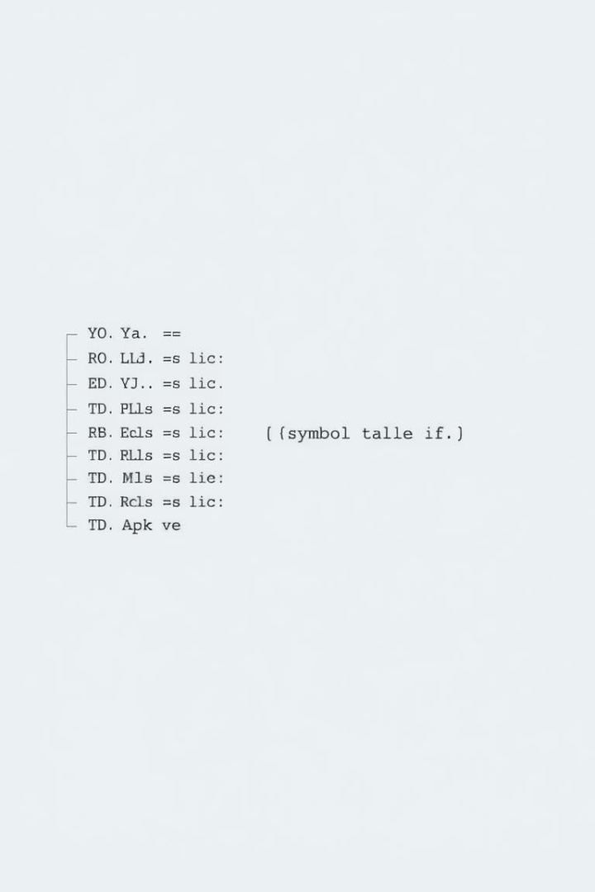
Activity 1: Array-Based Symbol Table
Implement a Symbol Table using an Array Data Structure.
Input Processing
Get user input and initialize data structures.
Line-by-Line
Split input into individual lines for analysis.
Token Generation
Create tokens for operators, variables, and constants.
Symbol Table Entry
Add variable information to a 2D array.

Slide 8
Activity 1: Key Code Logic
Symbol Table Structure
Symbol Table Entry Logic
String[,] SymbolTable = new String[20, 6];
// [Index][Variable Name][Type][Value][Line#][Reserved]
SymbolTable[row, 1] = row.ToString(); // Index
SymbolTable[row, 2] = finalArrayc[x].ToString(); // Variable name
SymbolTable[row, 3] = finalArrayc[x - 1].ToString(); // Type
SymbolTable[row, 4] = finalArrayc[x + 2].ToString(); // Value
SymbolTable[row, 5] = line_num.ToString(); // Line number
Regex Patterns
Regex variable_Reg = new Regex(@"^[A-Za-z_][A-Za-z0-9]*$");
Regex constants_Reg = new Regex(@"^[0-9]+([.][0-9]+)?([e]([+|-])?[0-9]+)?$");
Regex operators_Reg = new Regex(@"^[-*+/><&&||=]$");

Slide 9










Task 1: Hash-Based Symbol Table
Implement Symbol Table using Hash Function (Dictionary) for efficient storage.
Input Tokenization
Initialize Hash Table
Split input into tokens character by character.
Create Dictionary for symbol storage.
Token Processing
Classify tokens using regex patterns.
Duplicate Check
Avoid duplicate entries in hash table.
Hash Table Insertion
Add unique identifiers to Dictionary.

Slide 10
Task 1: Key Code Logic
Symbol Table Structure
static void LexicalAnalyzerFunction(string input){
Dictionary<string, string[]> symbolTable = new Dictionary<string, string[]>();
List<string> tokens = new List<string>();
string[] lines = input.Split('\n');
foreach (var line in lines){
string currentToken = "";
for (int i = 0; i < line.Length; i++){
char ch = line[i];
if (char.IsWhiteSpace(ch) || special_Reg.IsMatch(ch.ToString())){
if (!string.IsNullOrEmpty(currentToken)) {
ProcessToken(currentToken, tokens, symbolTable);
currentToken = "";}
if (special_Reg.IsMatch(ch.ToString())){
tokens.Add($"<punc, {ch}>");
}} else { currentToken += ch; } }
if (!string.IsNullOrEmpty(currentToken)) {
ProcessToken(currentToken, tokens, symbolTable);}}
DisplayTokens(tokens);
DisplaySymbolTable(symbolTable); }

Slide 11
Task 1: Key Code Logic
ProcessToken():
static void ProcessToken(string token, List<string> tokens, Dictionary<string, string[]> symbolTable){
if (keywordList.Contains(token)){
tokens.Add($"<keyword, {token}>");
}
else if (variable_Reg.IsMatch(token)){
tokens.Add($"<var, {token}>");
if (!symbolTable.ContainsKey(token)){
symbolTable.Add(token, new string[] { symbolTable.Count.ToString(), token, "int", "Unknown" });
}}
else if (constants_Reg.IsMatch(token)){
tokens.Add($"<constant, {token}>");
string type = token.Contains(".") ? "float" : "int";
if (!symbolTable.ContainsKey(token)){
symbolTable.Add(token, new string[] { symbolTable.Count.ToString(), token, type, token }); }}
else if (operators_Reg.IsMatch(token)){
tokens.Add($"<operator, {token}>"); }
else { Console.WriteLine($"Unknown token: {token}"); }}

